Slide 1
SHOP FOR HOME
TEAM MEMBERS:
RAAVI RAJA
MOHANACHARY NANDINI
ADDULAMALA MADHURI
VARANASI MADHURI

Slide 2
PROBLEM STATEMENT
Shop For Home is a popular Store in the market for shopping the home décor stuff . Due to Covid 19 all the offline shopping stopped. So, the store wants to move to the cloud platforms and wants their own web application.
CONTRIBUTION TO PROJECT :
Raavi Raja – worked on Frontend development
Varanasi Madhuri – worked on Frontend development
Addulamala Madhuri - worked on Backend development
Mohanachary Nandini - worked on Backend development

Slide 3
SOFTWARES USED
1) FRONTEND :
Angular
Boot strap
Angular Material
2) BACKEND :
Spring tool suite
Postgresql

Slide 4
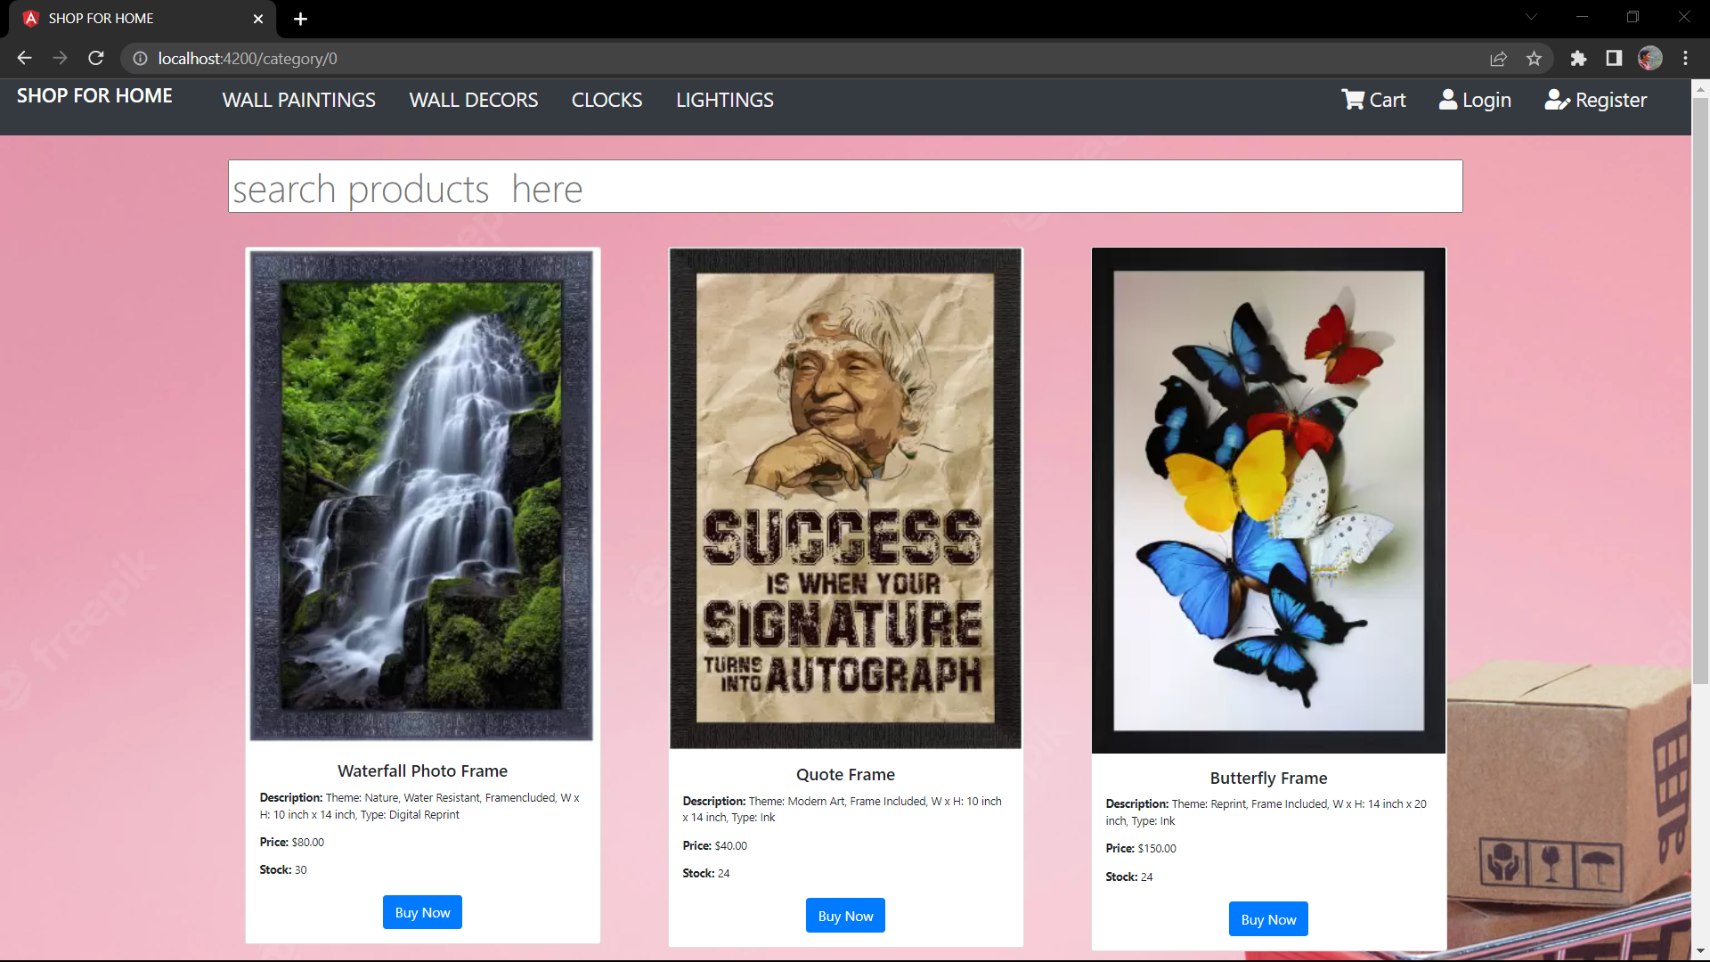
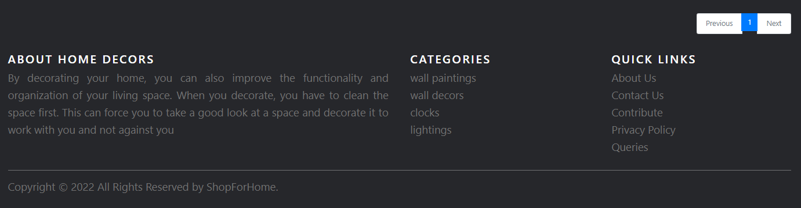
HOME PAGE OF WEBSITE

Slide 5
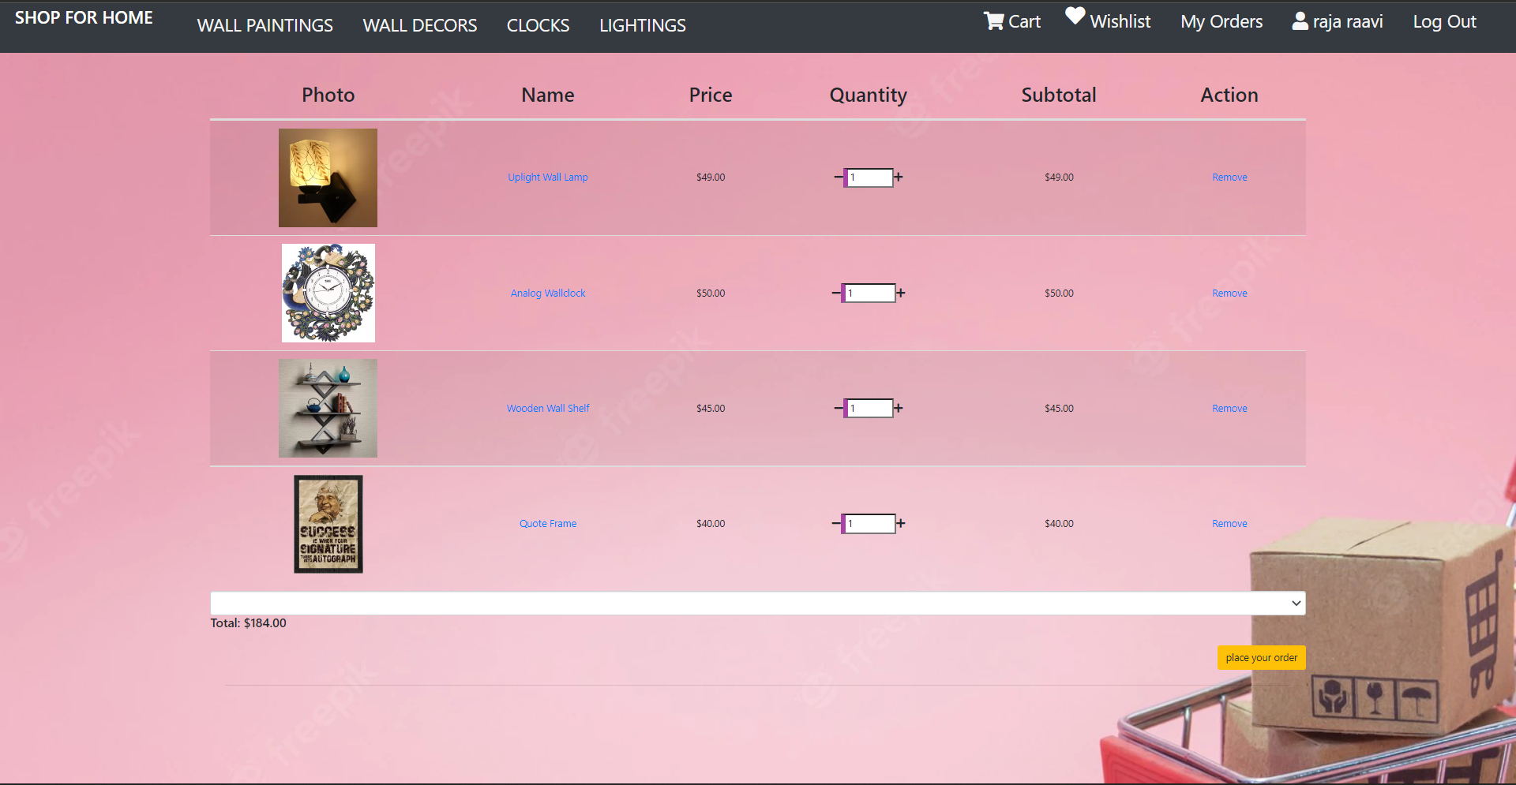
CART OPTION

Slide 6
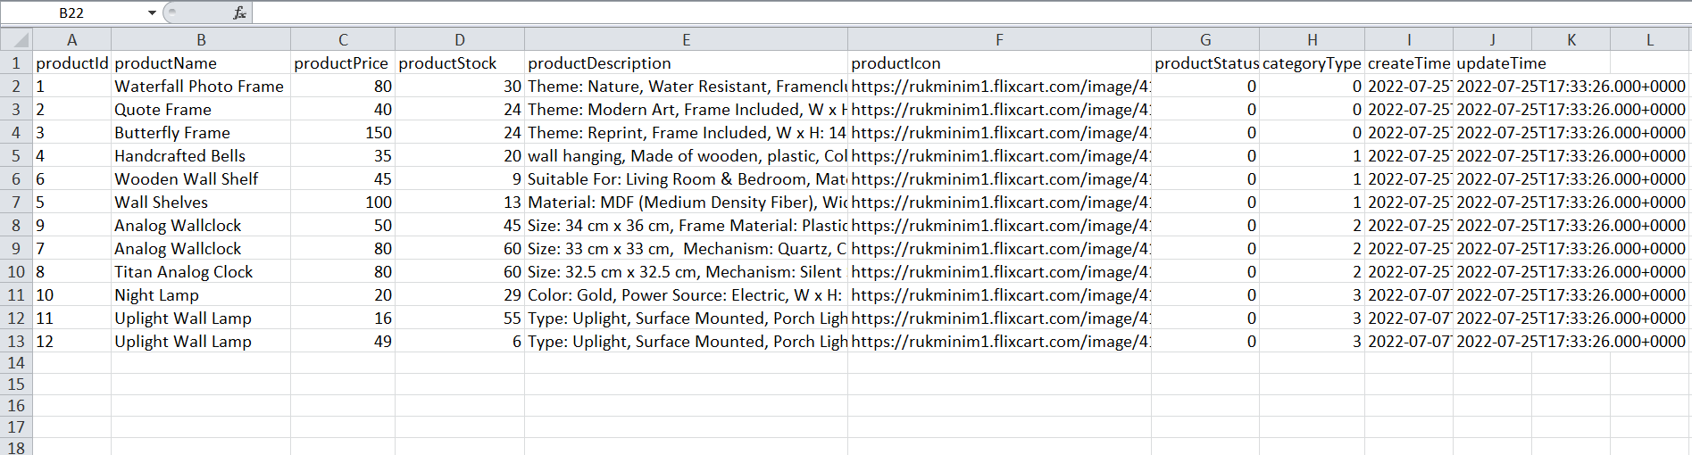
STOCK AND SALES REPORT

Slide 7
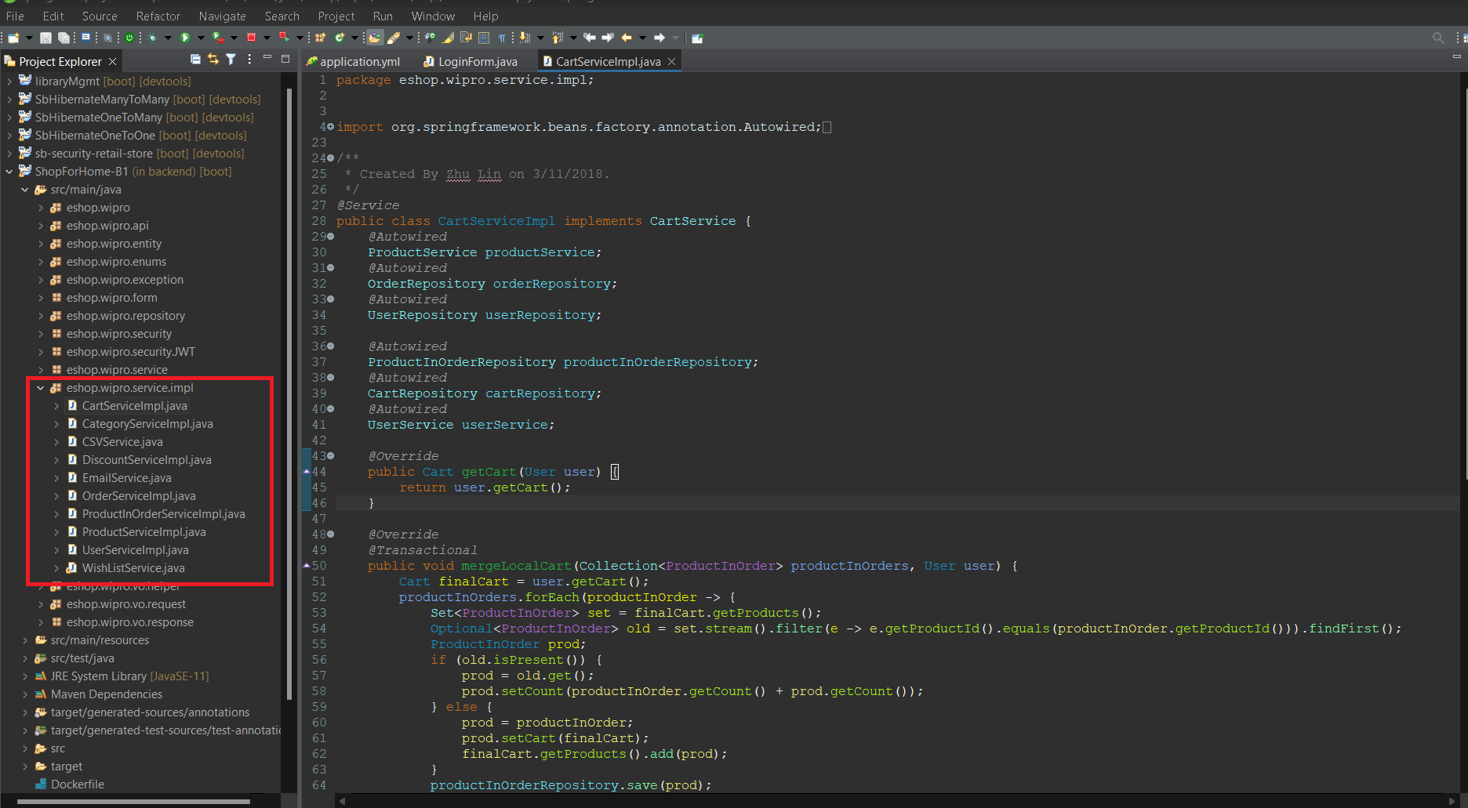
SERVICE LAYER IMPLEMENTATION

Slide 8
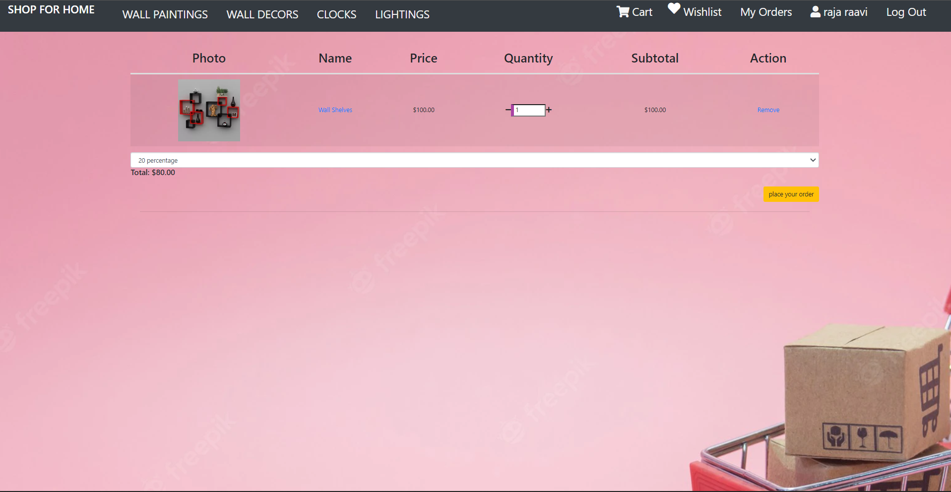
DISCOUNT MICROSERVICE

Slide 9
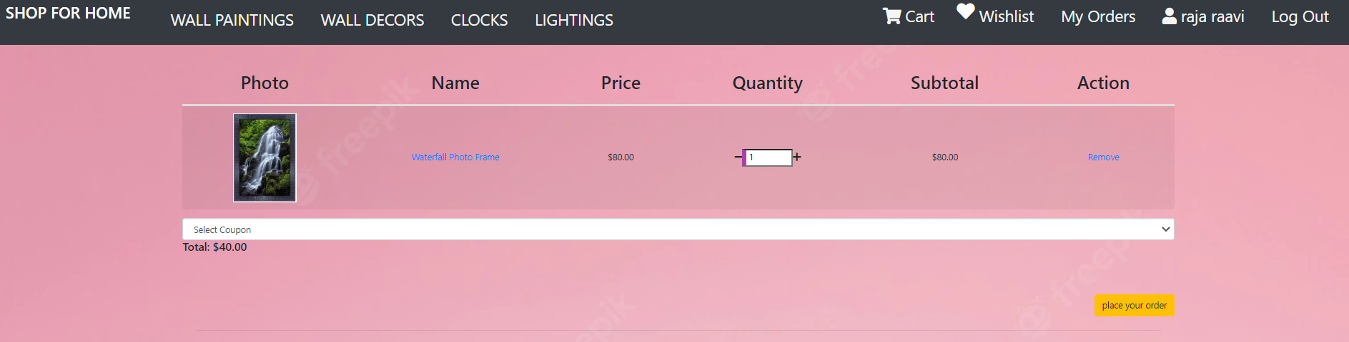
USER 1- WITH 50% off (Cont..)

Slide 10
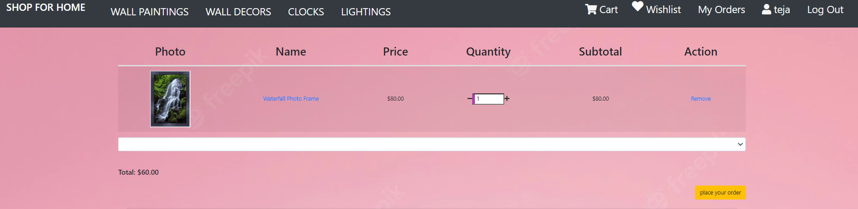
USER 2 – WITH 25% off (Cont..)

Slide 11
APPLICATION DEPLOYMENT PROCEDURE ON VMs
Step-1: sudo apt update
Step-2: sudo apt install openjdk-11-jdk
Step-3: sudo apt install nodejs npm –y
Step-4: sudo apt install maven
Step-5: sudo apt install git
Step-6: sudo apt install postgresql postgresql-contrib
Step-7: sudo –u postgres psql postgres
Step-8: \password postgres
Step-9: CREATE EXTENSION adminpack;
Step-10: git clone https://github.com/raja-raavi/B1-shopforhome.git
Step-11: cd B1-shoppforhome, backend
Step-12: mvn install
Step-13: mvn spring-boot:run

Slide 12
APPLICATION DEPLOYMENT PROCEDURE ON VMs (cont..)
Step-14: cd frontend-project
Step-15: sudo npm install –g @angular/cli
Step-16: ng serve

Slide 13
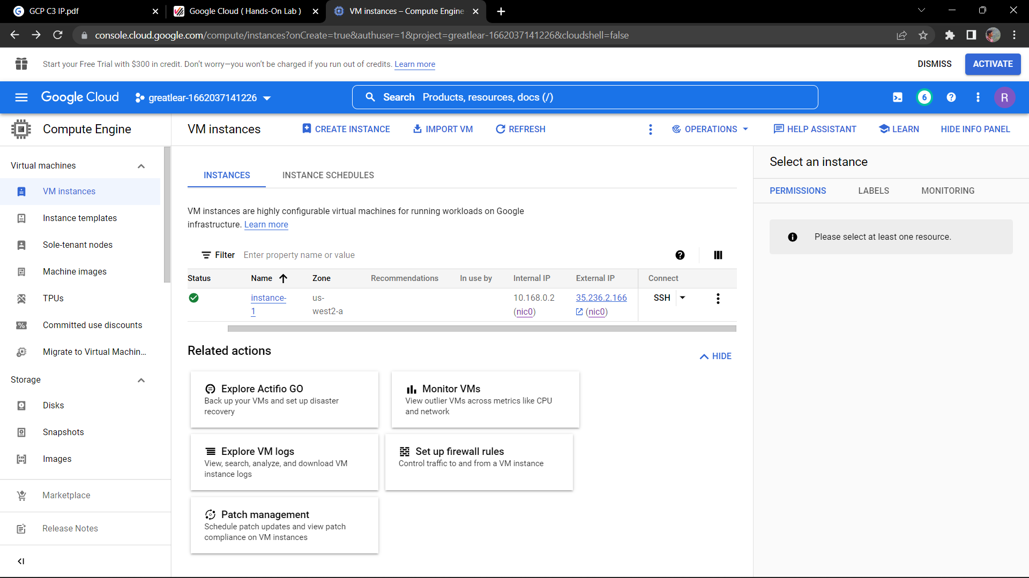
CREATING VM INSTANCE

Slide 14
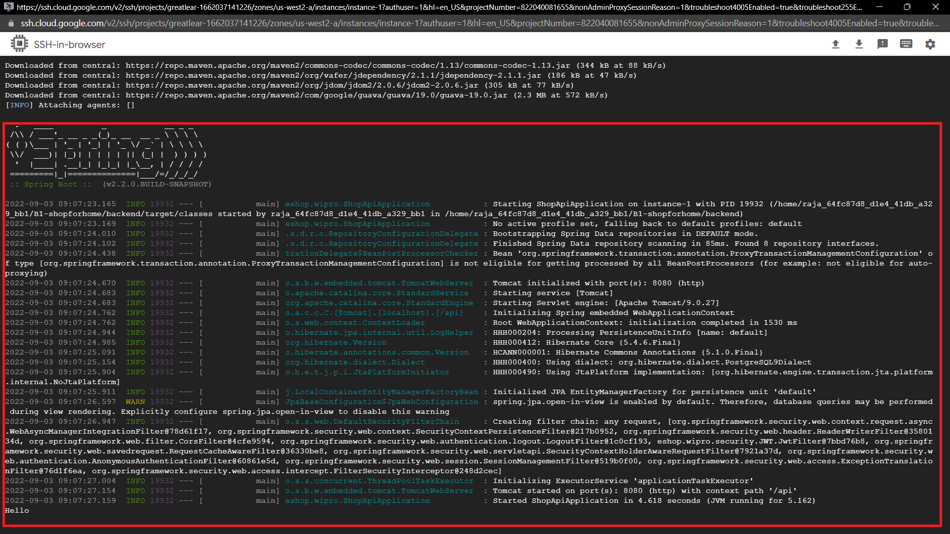
BACKEND DEPLOYMENT ON VMs

Slide 15
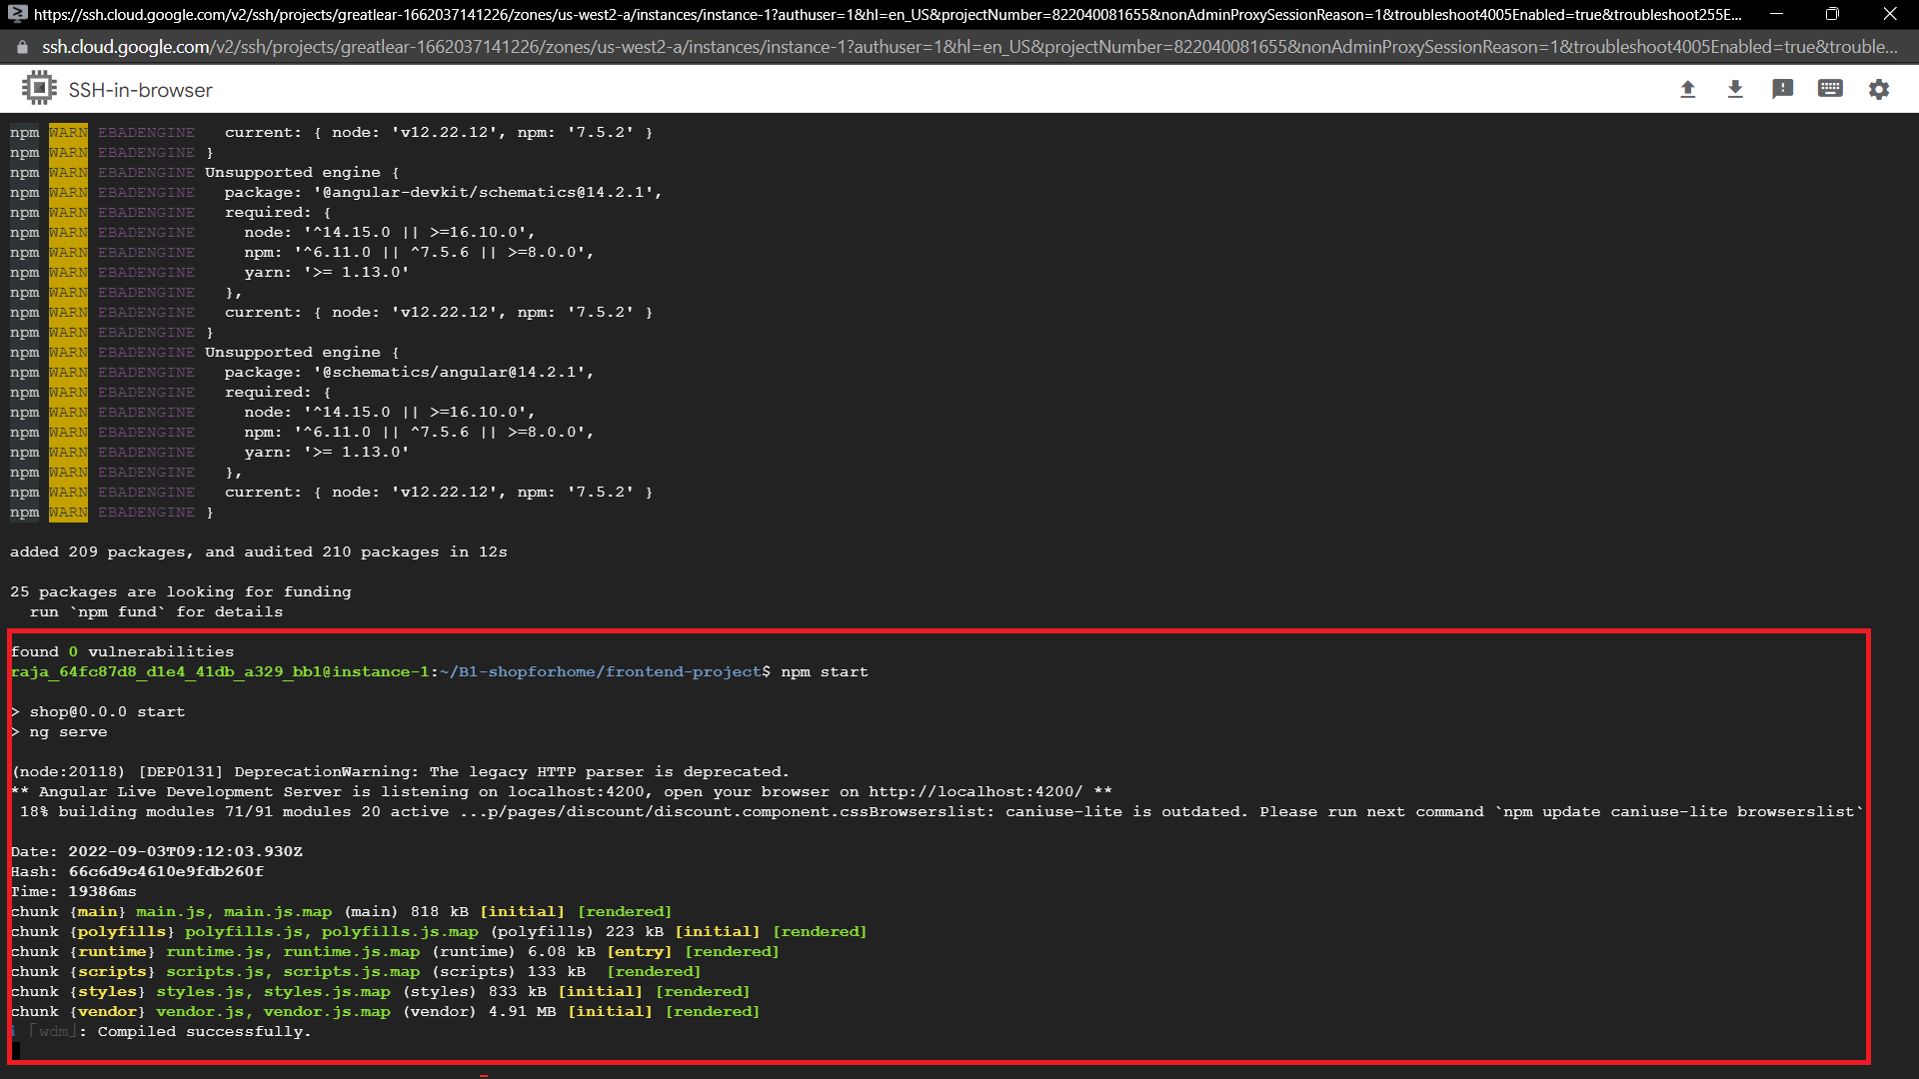
FRONTENDDEPLOYMENT ON VMs

Slide 16
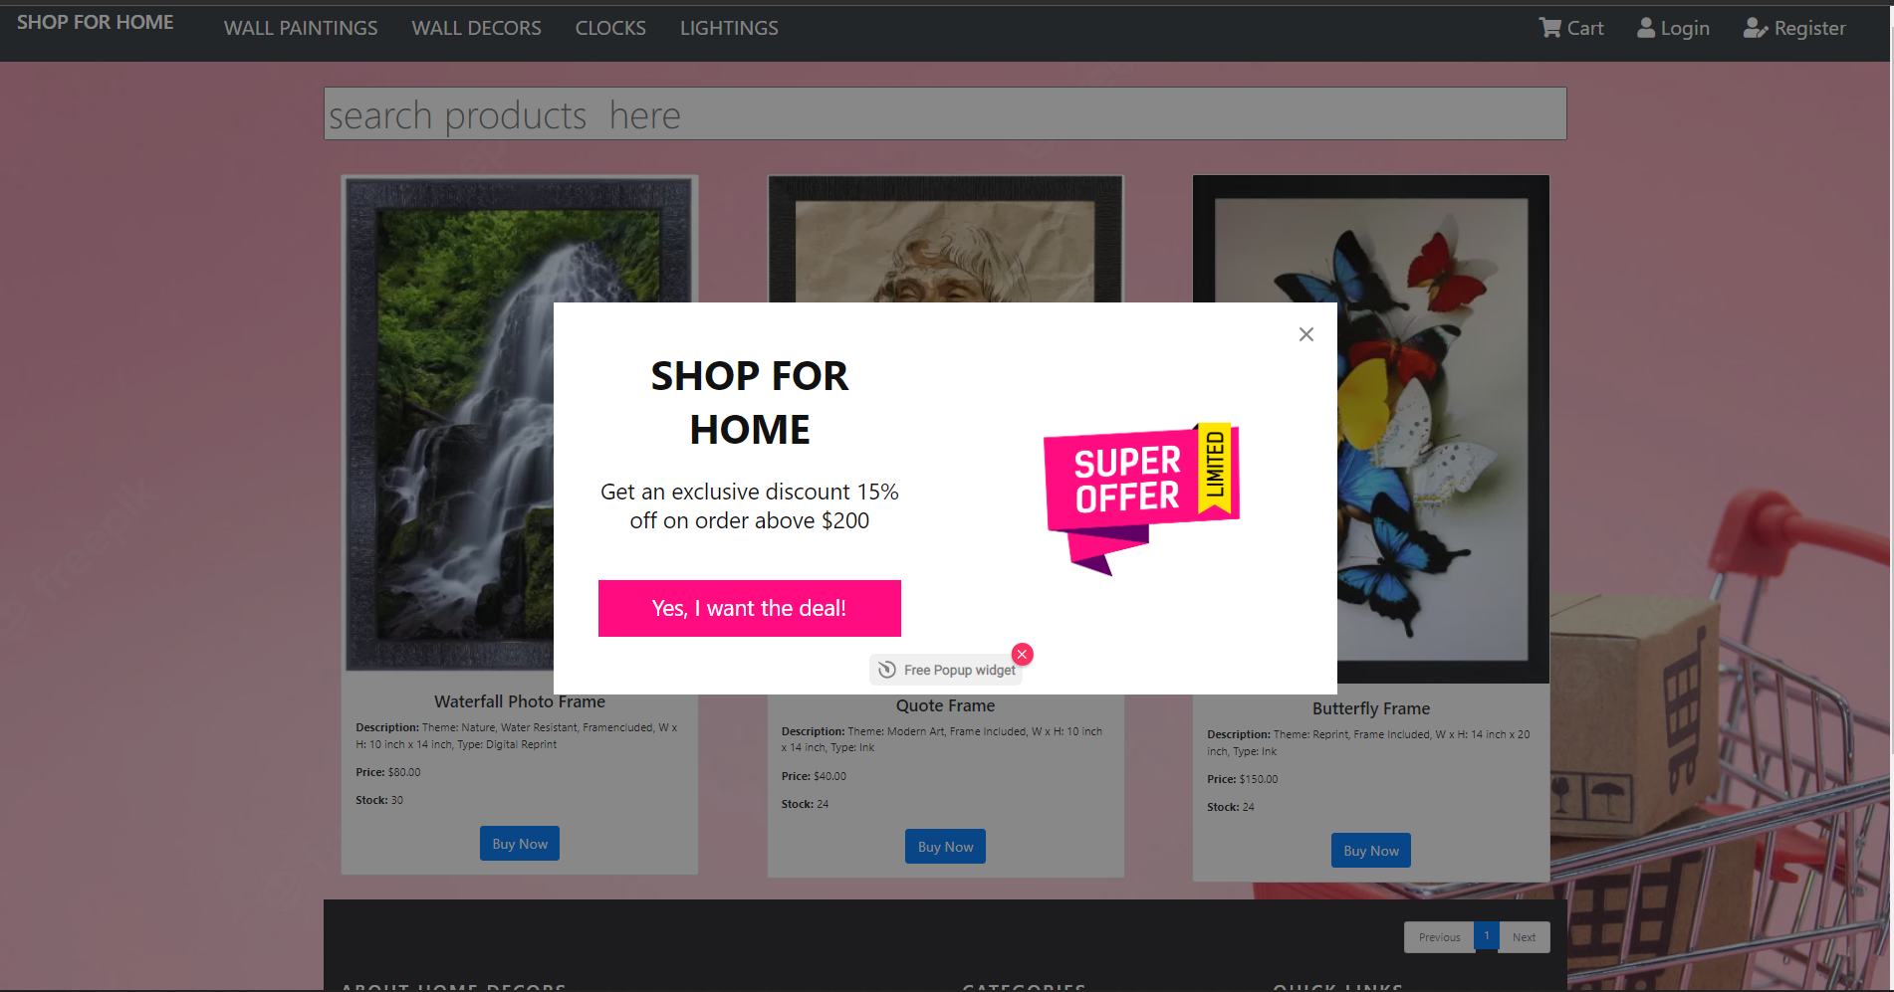
OUTPUT PAGE AFTER DEPLOYMENT

Slide 17
CONCLUSION
Thus the Shop For Home web application is developed as the instructions
Since the nine objectives listed in sprint 2 document are all effectively implemented

Slide 18
THANK YOU

